Slide 1
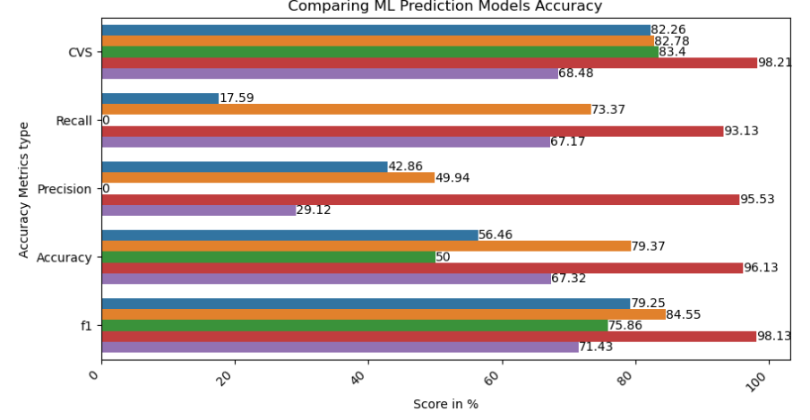
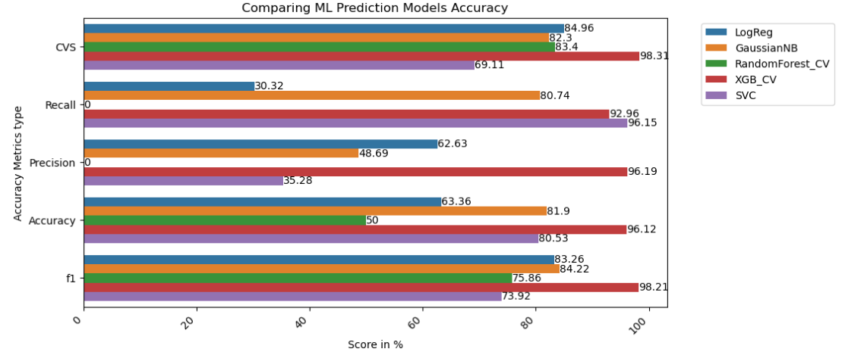
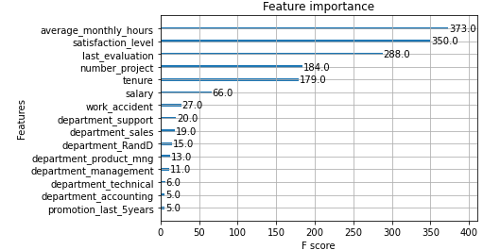
Predicting Employee Turnover
Prepared for Salifort Motors
Create a predictive model using python, with data collected to determine the factors that contribute to high employee turnover.
Determine insights that can help Senior Management and HR to make policies that can improve employee retention
SUMMARY
Tested 5 models, logistic or tree-based, to determine which model will give the most accurate outcome.
XGB came out on top, scoring over 90% on all measured metrics.
The average monthly hours worked by employees are significantly higher than average (8.5hr days, 5 day weeks). This was top on the feature importance from the model.
Number of Projects is another key feature.
Further analysis can be done with more data collection (Info such as overtime hours, average weekly hours, etc). More models can be looked into to give a more definitive answer on feature’s influences.
Management and HR needs to look into making policies such as
Capping the number of projects
Reducing the hours worked
Average_monthly_hours is top on feature importance.
In the EDA, found that satisfaction levels and last evaluation are related to average_monthly_hours and number_projects.
Workers generally left when given long hours, and high number of projects (6 & 7)

